Slide 1
Lublin University of Technology – Past and Present
Lublin University of Technology – Past and Present, Science and Education, University Units, Investments, International Cooperation, Student Life

Slide 2
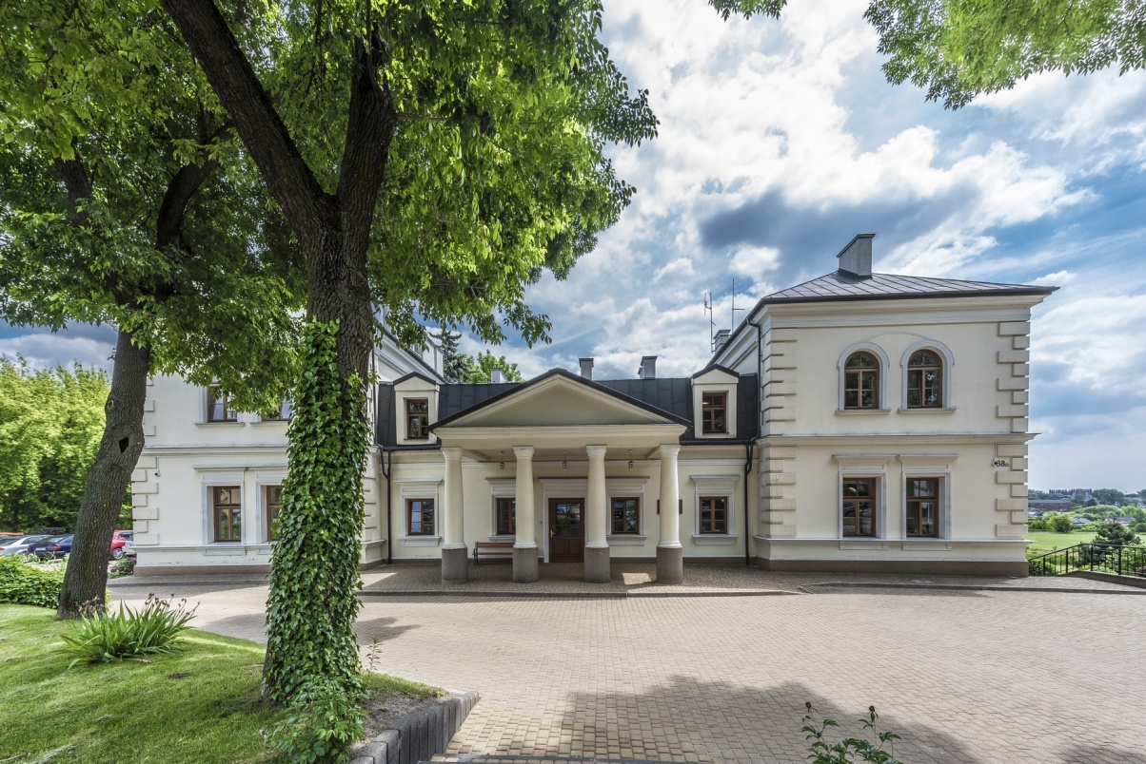
Lublin University of Technology – Past and Present Wczoraj i Dziś
1953 – Lublin University of Technology was established on the initiative of Lublin’s technicians and engineers as Evening Engineering School
1965 – Evening Engineering School was transformed into Higher School of Engineering offering full-time, evening and extramural courses
1977 – Higher School of Engineering was transformed into Lublin University of Technology based on the Regulation of the Council of Ministers
Rector’s Office

Slide 3
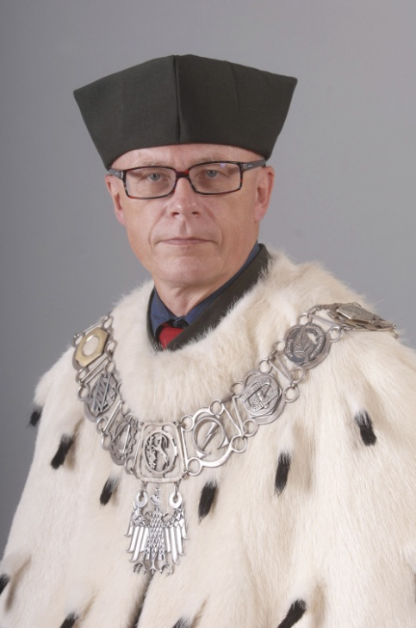
Lublin University of Technology’s Authorities
Terms of office: 2012-2016, 2016-2020
RECTOR prof. Piotr Kacejko, PhD, DSc (Eng.)

Slide 4
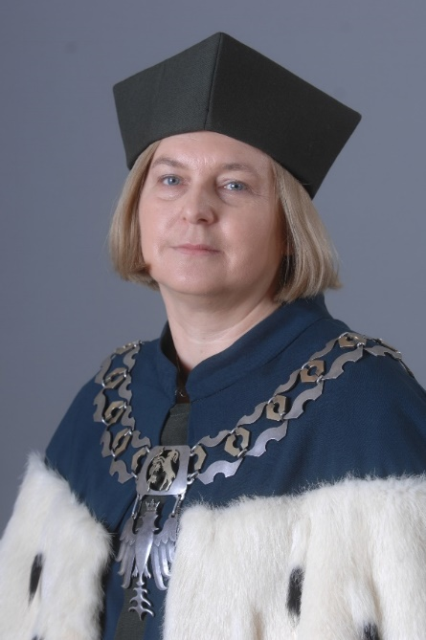
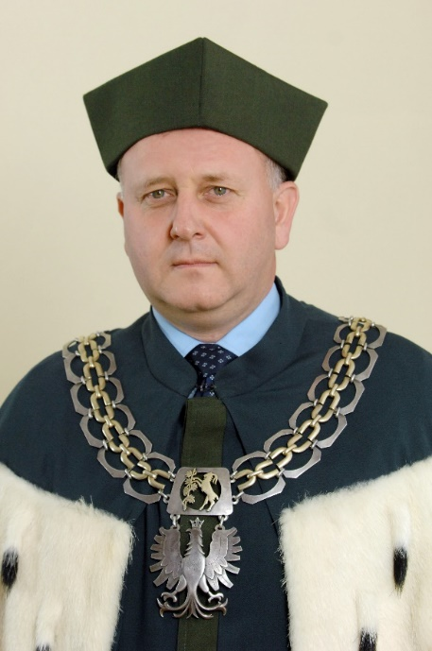
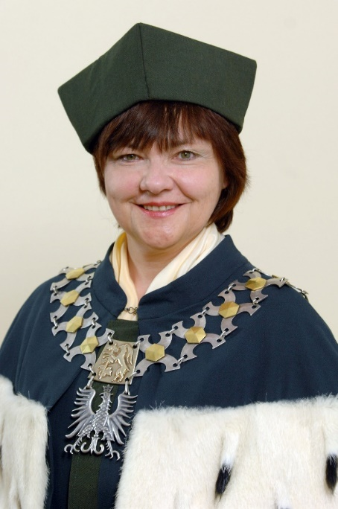
Lublin University of Technology’s Authorities
Term of office: 2016-2020
DEPUTY RECTOR for Scientific Affairs
prof. Marzenna Dudzińska, PhD, DSc
DEPUTY RECTOR for Student Affairs Paweł Droździel, PhD, DSc (Eng.), Associate Professor
DEPUTY RECOR for Cooperation with Social and Business Environment Anna Halicka, PhD, DSc (Eng.), Associate Professor

Slide 5
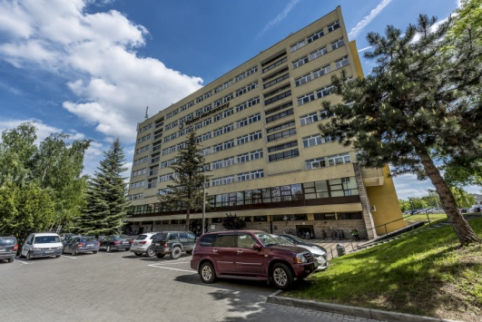
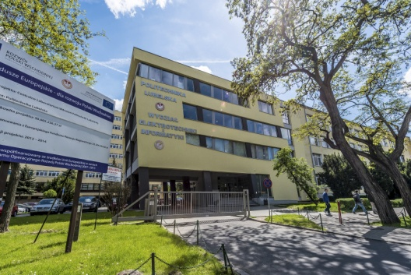
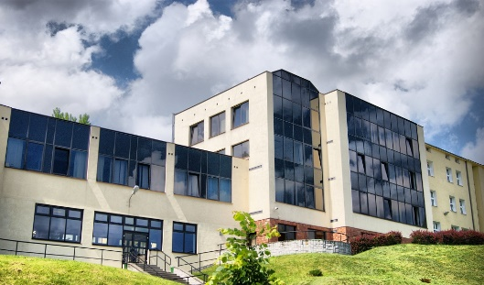
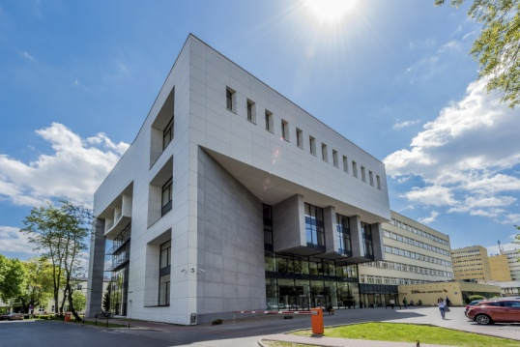
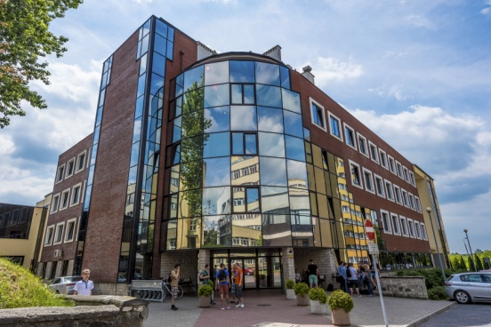
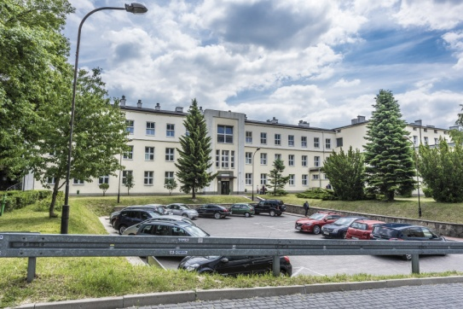
Science and Education
There are six Faculties at Lublin University of Technology
Faculty of Mechanical Engineering
Faculty of Electrical Engineering and Computer Science
Faculty of Civil Engineering and Architecture
Faculty of Environmental Engineering
Faculty of Fundamentals of Technology
Faculty of Management

Slide 6
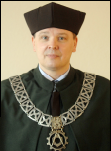
Faculty of Mechanical Engineering
Faculty’s Authorities
Fields of Studies
Biomedical Engineering (conducted jointly with the Faculty of Electrical Engineering)
Materials Engineering
Production Engineering
Mechanics and Machine Design
Mechatronics (conducted jointly with the Faculty of Electrical Engineering)
Transport
Management and Production Engineering (conducted jointly with the Faculty of Management)
Dean prof. Zbigniew Pater, PhD, DSc (Eng.)
About the Faculty
In 2017 the Ministry of Science and Higher Education considered the Faculty of Mechanical Engineering at LUT as the best in the country in the scientific and creative achievements category and as the third in the country in respect of practical effects of research.

Slide 7
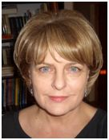
Faculty of Electrical Engineering and Computer Science
Faculty’s Authorities
Fields of Studies
Electrical Engineering
Computer Science
Biomedical Engineering (conducted jointly with the Faculty of Mechanical Engineering)
Mechatronics (conducted jointly with the Faculty of Mechanical Engineering)
Dean prof. Henryka Danuta Stryczewska, PhD, DSc (Eng.)
About the Faculty
In 2017 the Faculty of Electrical Engineering and Computer Science was granted Category A by the Committee for the Evaluation of Scientific Units.

Slide 8
Faculty of Civil Engineering and Architecture
Faculty’s Authorities
Fields of Studies
Architecture
Civil Engineering
Dean Bogusław Szmygin, PhD, DSc (Eng.)
About the Faculty
In 2017 the Faculty of Civil Engineering and Architecture was granted Category A by the Committee for the Evaluation of Scientific Units.

Slide 9
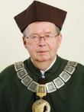
Faculty of Environmental Engineering
Faculty’s Authorities
Fields of Studies
Environmental Engineering
Renewable Energy Engineering
Dean prof. Witold Stępniewski, PhD, DSc
About the Faculty
In 2017 the Committee for the Evaluation of Scientific Units granted the Faculty of Environmental Engineering Category A.

Slide 10
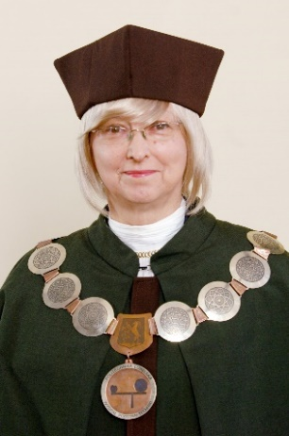
Faculty of Fundamentals of Technology
Faculty’s Authorities
Fields of Studies
Technical and Science Education
Security Engineering
Mathematics
Dean Dorota Wójcicka-Migasiuk, PhD, DSc (Eng.)
About the Faculty
In 2017 the Committee for the Evaluation of Scientific Units granted the Faculty of Fundamentals of Technology Category B.

Slide 11
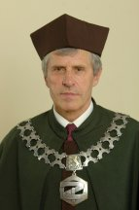
Faculty of Management
Faculty’s Authorities
Fields of Studies
Finance and Accounting
Marketing and Marketing Communication
Management
Management and Production Engineering (conducted jointly with the Faculty of Mechanical Engineering)
Dean prof. Stanisław Skowron, PhD, DSc (Eng.)
About the Faculty
In 2017 the Committee for the Evaluation of Scientific Units granted the Faculty of Management Category B.

Slide 12
University Units
Library
The Library offers technical literature, scripts, coursebooks, information books on technical and related subjects as well as general and specialists magazines which are available to students, academics and staff. Specialists can also use resources on standardisation, patents and technical approvals. The Library as the only one in the region has access to the full set of the current Polish Standards in the electronic form.
Office for Promotion and Projects
The Office for Promotion and Projects manages the application and implementation of EU-founded projects. It provides support in writing projects under PO WER competitions. Moreover, the Office actively promotes University’s educational offer along with academics’ scientific and technological achievements.
Career Services Office
The Career Services Office links the labour market with University. It provides students with job and internships offers along with information on employers and current situation on the labour market. The Office helps students and graduates in choosing career paths and carries out consultations and group workshops concerning career planning.

Slide 13
University Units
Office of International Education
The Office of International Education handles international exchange. It initiates, promotes and implements mobility projects and helps students, academics and staff in issues concerning mobility. Besides, the Office coordinates foreign students enrolment process for studies in English and cooperates with organisations such as Erasmus Student Network.
IT Centre
The main tasks of the IT Centre include the maintenance and development of LAN backbone infrastructure, coordination and implementation of the campus wireless access unified system, maintenance and adaptation of computer network in University’s facilities, administering Lublin University of Technology’s website – www.pollub.pl in the scope of mail server, its main website and websites of faculties and other University’s units.

Slide 14
University Units
Centre for Innovation and Technology Transfer
The Centre for Innovation and Technology Transfer handles the commercialisation management of research results, gives opinions on innovation to obtain grants. It offers services concerning consultancy in R+D projects preparation in science-industry consortia, as well as information and advice related to technology transfer, IPR and internationalisation of companies.
Lublin Academic Business Incubator
The aim of Lublin Academic Business Incubator is to support entrepreneurship by developing conditions for young and creative people to appear in the business world. It also supports incubated companies in developing their brands and consolidating their position in the market.

Slide 15
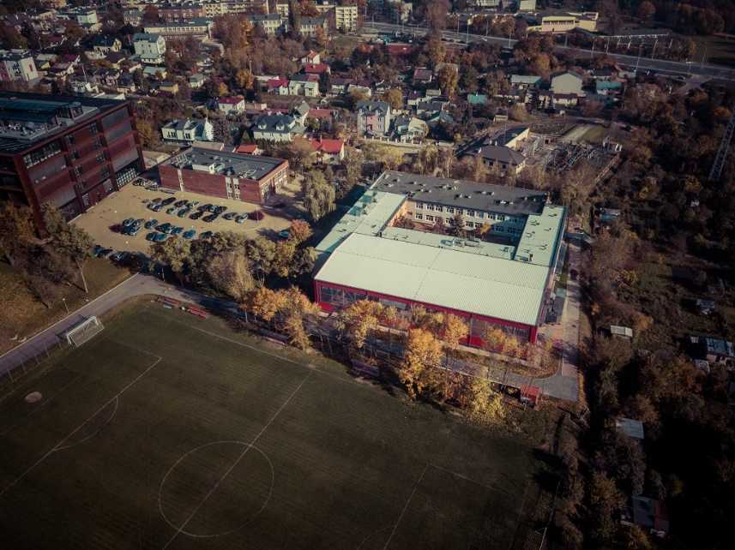
University Units
Department of Foreign Languages
The Department of Foreign Languages employs nearly 30 teachers giving classes in English, German, Russian and Spanish. Foreign students studying under Erasmus+ programme and other international students are offered Polish as a foreign language courses.
Department of Physical Education and Sport
The Department of Physical Education and Sport deals with physical education. The Department’s main tasks include organising educational processes for students who attend mandatory PE classes and conducting sport section classes for students keen on sport.

Slide 16
Investments
The University’s development is accompanied by large-scale investments.
Lublin University of Technology completed four investments under 2007-2013 Operational Programme – Development of Eastern Poland:
Centre for Innovation and Advanced Technologies which houses 32 highly-specialised labs and teaching and research facilities
Central Implementation Laboratory the aim of which was to buy high-tech equipment for conducting certified research and measurements
Eastern Innovative Centre of Architecture which aimed to develop a teaching and research base and innovative IT labs used in architecture, urban and spatial planning
Expansion and modernisation of the educational and research potential of the Faculty of Civil Engineering and Architecture

Slide 17
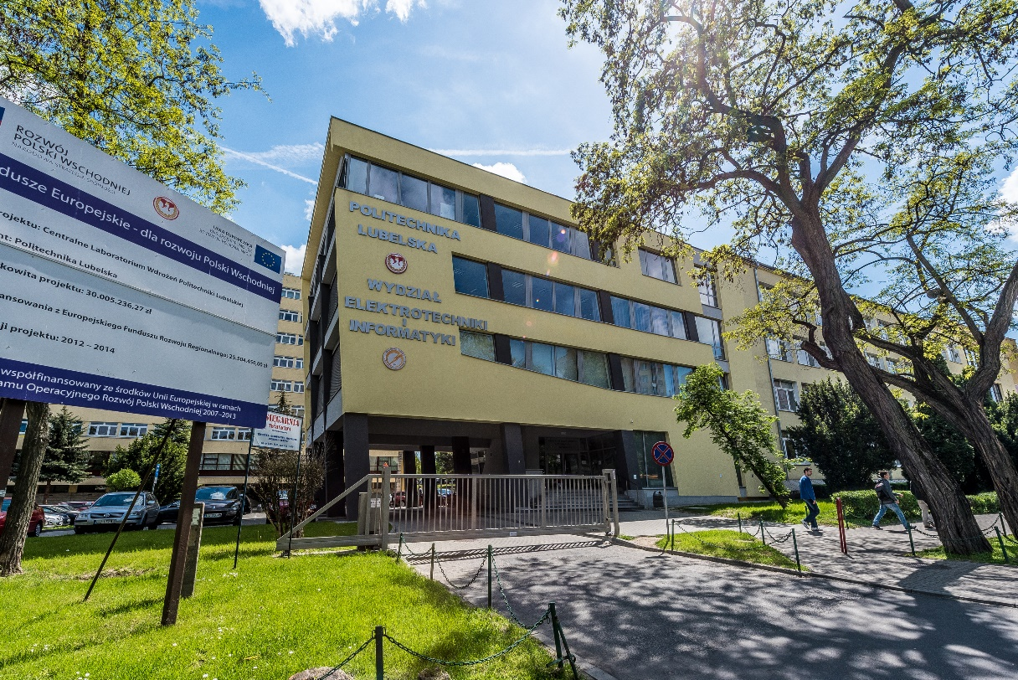
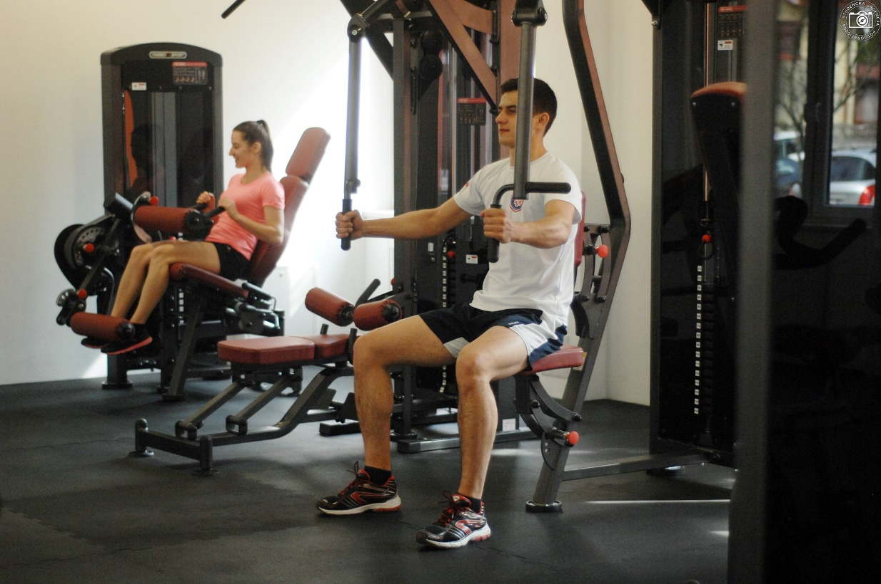
Investments
Facilities co-financed by the Ministry of Science and Higher Education:
In 2014 built was Electronics, Automatics and ICT Centre of the Faculty Electrical Engineering and Computer Science.
In 2016 modernized was the Sport Centre.

Slide 18
International Cooperation
Lublin University of Technology cooperates with institutes and scientific research centres all over the world. Over 160 bilateral agreements have been signed under which conducted is collaborative research and also visits combined with lectures and internships. Moreover, organised are international conferences and joint projects as well as signed are bilateral and double degree agreements.
Lublin University of Technology has signed agreements with Universities in:
Western Europe: France, Germany, Netherlands, Portugal, Spain, Switzerland
Eastern Europe: Russia, Ukraine, Belarus, Czech Republic, Slovakia
Northern Europe: Denmark, Finland, Ireland, Great Britain, Lithuania, Latvia
Southern Europe: Italy, San Marino
Balkans, Greece, Croatia, Bulgaria, Serbia
Asia: Turkey, Georgia, Indie, Japan, China, Kazakhstan, Kyrgyzstan, Uzbekistan, Azerbaijan
Near East: Israel
Northern and Southern America: Mexico, USA, Brazil
Oceania: Australia

Slide 19
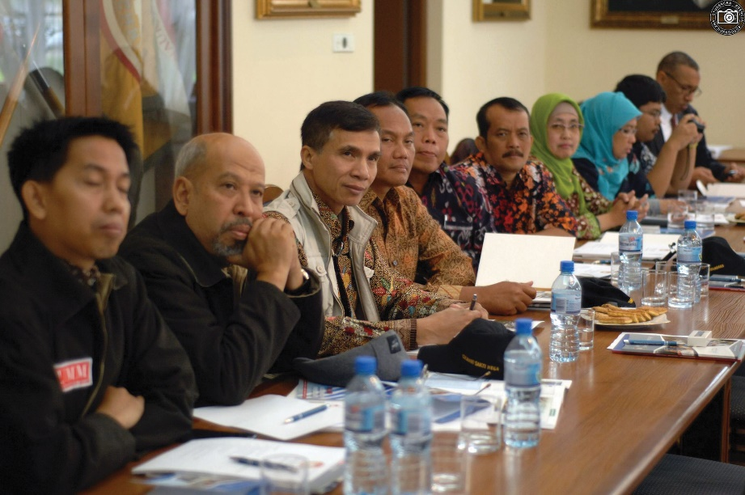
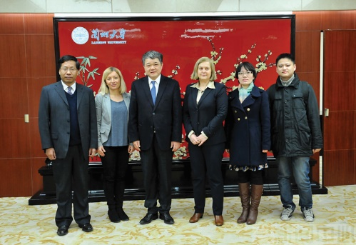
International Cooperation
Lublin University of Technology actively participates in many EU research, both as a coordinator and the consortium member. The most notable projects, ongoing and finished, financed with the EU 7th Framework Programme and Horizon 2020 include: NEWEX, PNANO4BONE, MOWOM, SMART Value, PVs in BLOOM and Plasma Sterilization.
By intense international cooperation, research and technology transfer Lublin University of Technology aims to excel in relations between researches and employers or grant-holders in accordance with the Charter for Researches and the Code of Conduct for the Recruitment and Researchers.

Slide 20
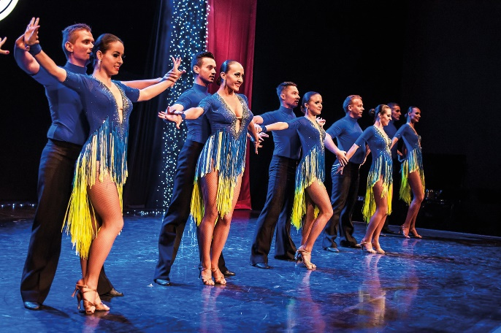
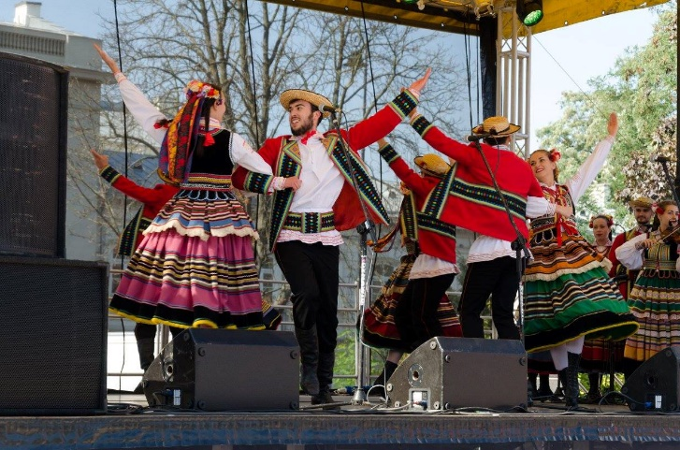
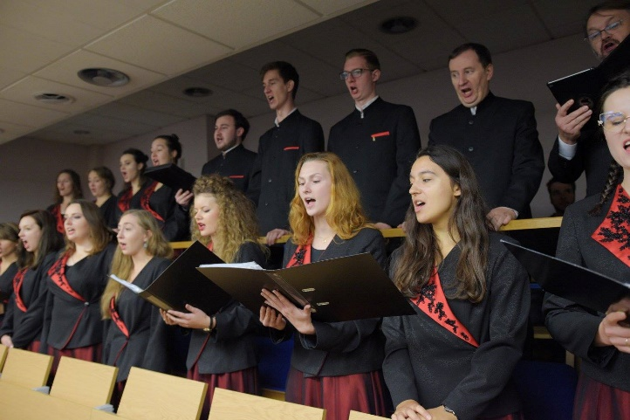
Student Life
Student Government actively participates in University's decision-making processes. The key ones include fostering decisions which serve the development of the student environment and protection of its rights. The Student Government organises student integration events, such as: initiation ceremonies, St. Andrew’s Eve ceremonies and student May festival.
Music and Dance Groups are invaluable assets of Lublin University of Technology. It can distinguish itself from other technical universities in terms of the number and artistic level of its music, dance and theatre groups. Students can pursue their interests by becoming members of Gamza Ballroom Dance Formation, Modern Dance Group, Song and Dance Assemble, Academic Choir and other music groups which add splendour to important cultural events at Lublin University of Technology but also in Lublin and its region.

Slide 21
Student Life
Media at Lublin University of Technology consists of "Plagiat" Student Magazine, Student Photo Agency, and Pollub.TV Student Internet TV. Though them in the form of films, photos and articles students present vibrant academic life.
Science Clubs give students an exciting opportunity to develop their passions and interests. There are numerous Science Clubs at Lublin University of Technology the aim of which is to do research but also exchange experiences and gain new knowledge. By putting their knowledge into practice students of Lublin University of Technology are the best ambassadors of the University in Poland and abroad.
Academic Sport Association plays an important life in University’s life. The Association has the following sport sections: fitness, futsal, swimming pool, gym, tennis, zumba, badminton, sports bridge, rowing ergometer, kick-boxing, mountain biking, baseball, football, handball, volleyball, chess, table tennis, lawn tennis, powerlifting and sailing.
Dormitories are located at the campus of Lublin University of Technology. They can accommodate nearly 1000 students. Monthly fee for a dormitory in 2017/2018 academic year is PLN 345 per person.

Slide 22
Contact
LUBLIN UNIVERSITY OF TECHNOLOGY
Nadbystrzycka 38D Street
20-618 Lublin
Tel.: 81 538 41 40
Email: politechnika@pollub.pl
www.pollub.pl

